Slide 1


Bike-Sharing
Hsin-Yu Hu
Nan Ma
Shuang Su
I-Ting Yu
FNCE 3490 – DATA SCIENCE AND BUSINESS ANALYTICS | 2016

Slide 2

Agenda
Introduction
Project Goal
Model Selection
Data Analysis/ Explorations
Summary

Slide 3
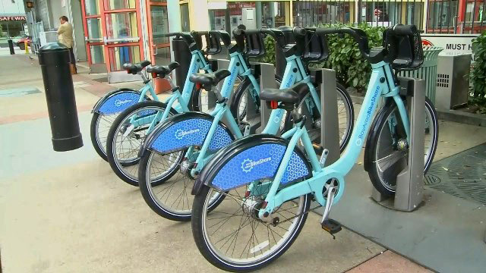
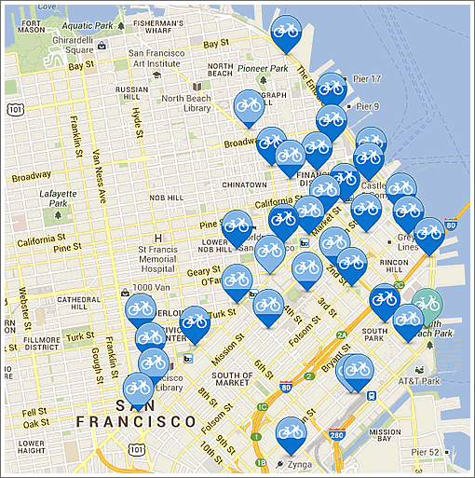
Bike-Sharing System

Slide 4
Project Goal
Predict the number of bike rental hourly needed

Slide 5
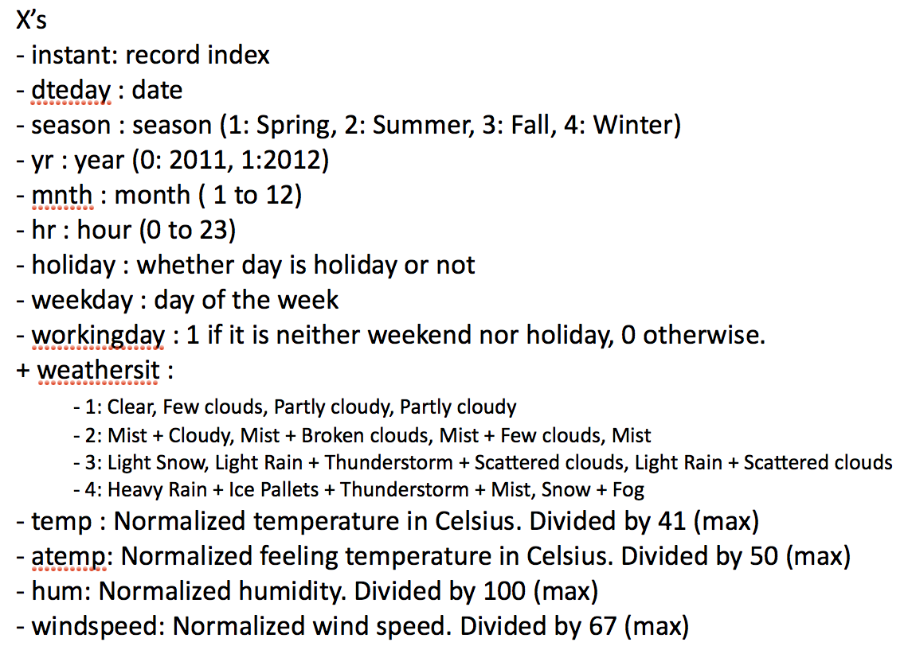
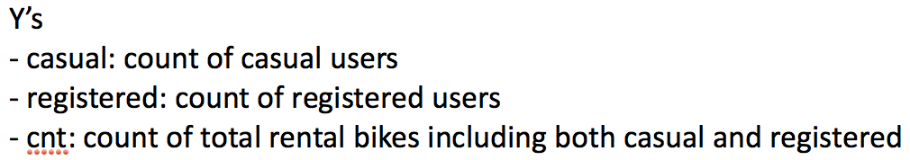
Dataset (UCI Machine Learning Repository)

Slide 6
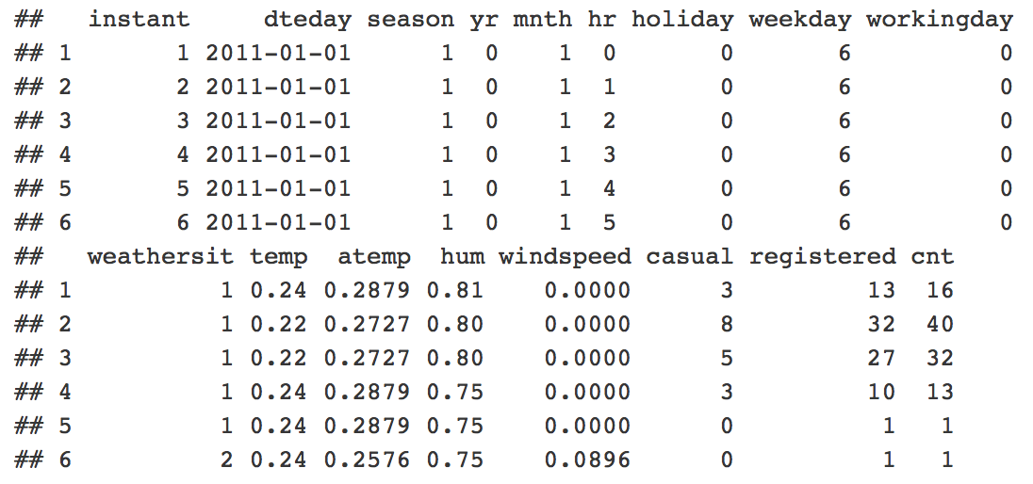
Sample Records

Slide 7
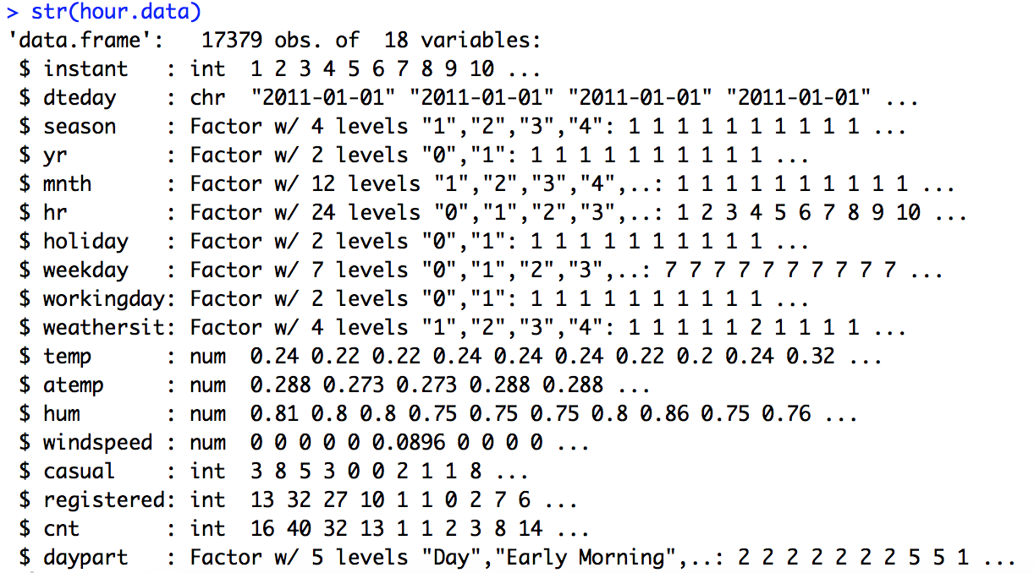
Dataset (Factorization)
Notes:
Bike-sharing rental process is highly correlated to the environmental and seasonal settings.
For instance, weather conditions, precipitation, day of week, season, hour of the day, etc. can affect the rental behaviors.
The core data set is related to the two-year historical log corresponding to years 2011 and 2012 from Capital Bikeshare system, Washington D.C.

Slide 8
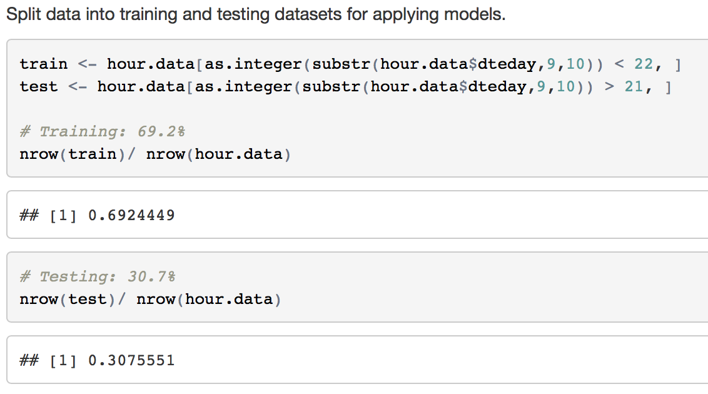
Split

Slide 9
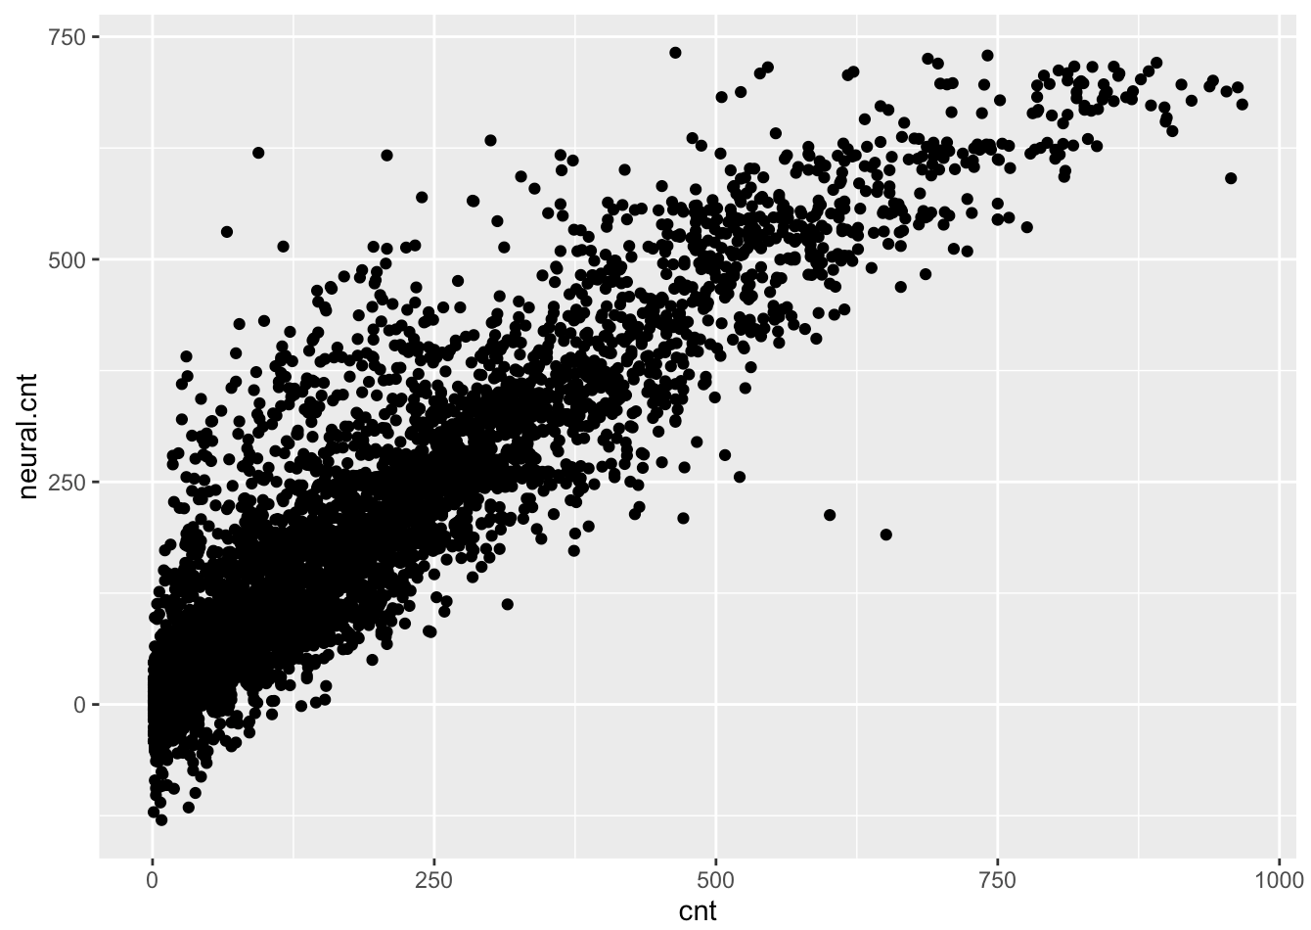
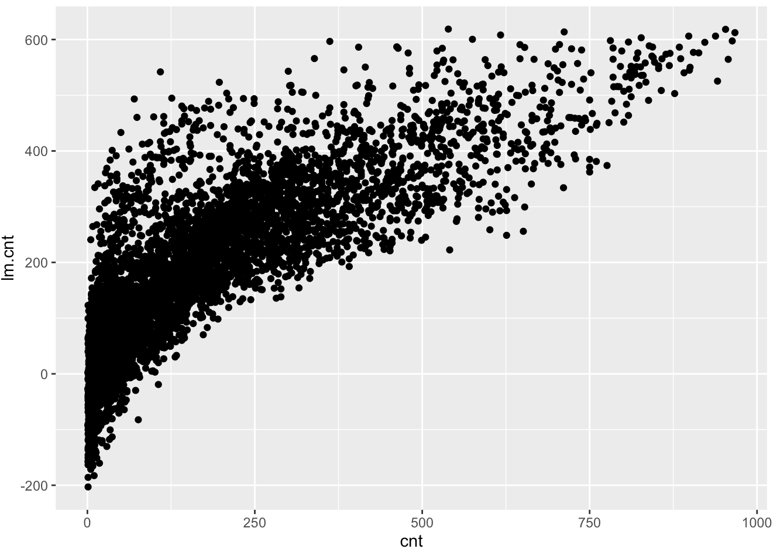
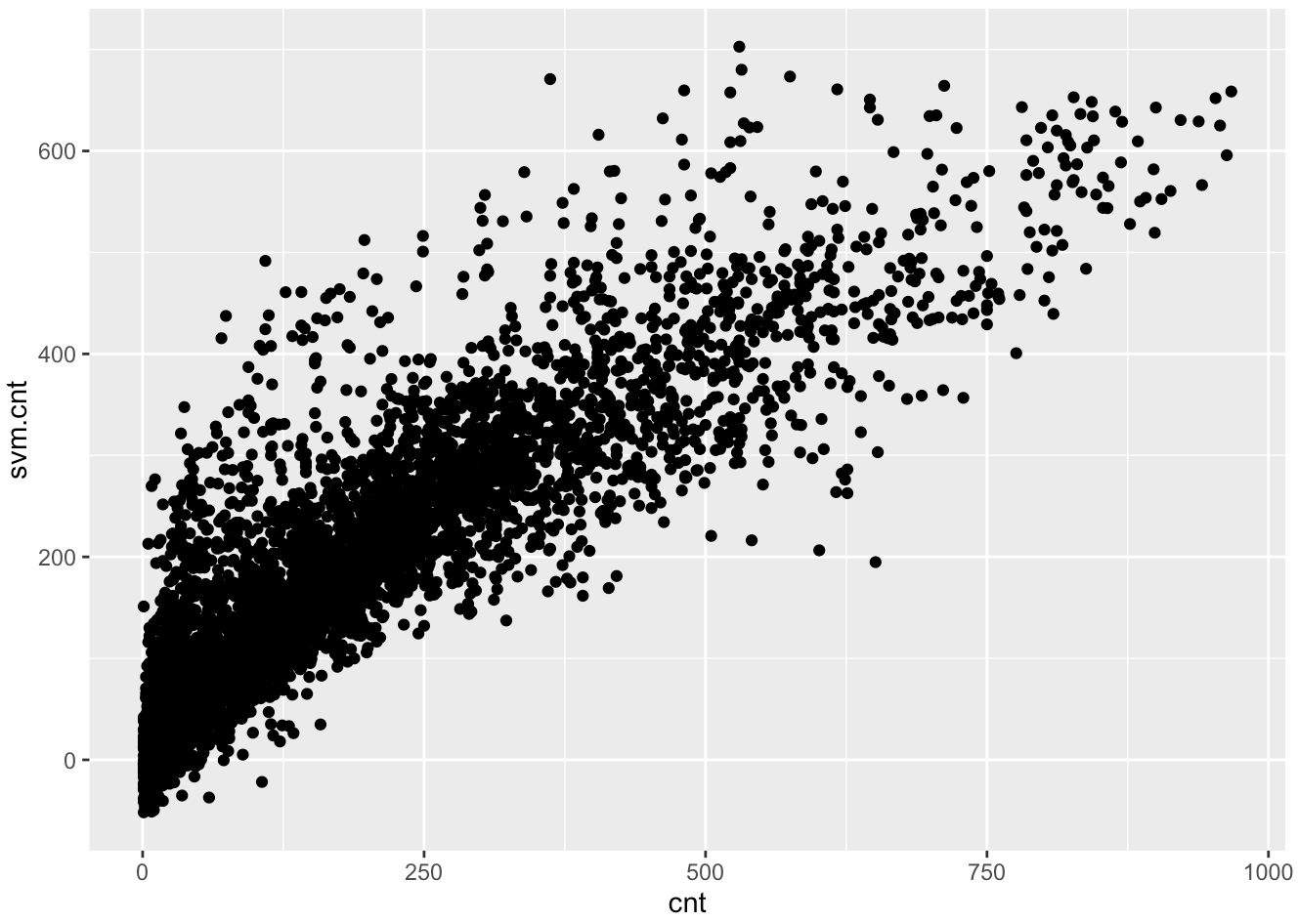
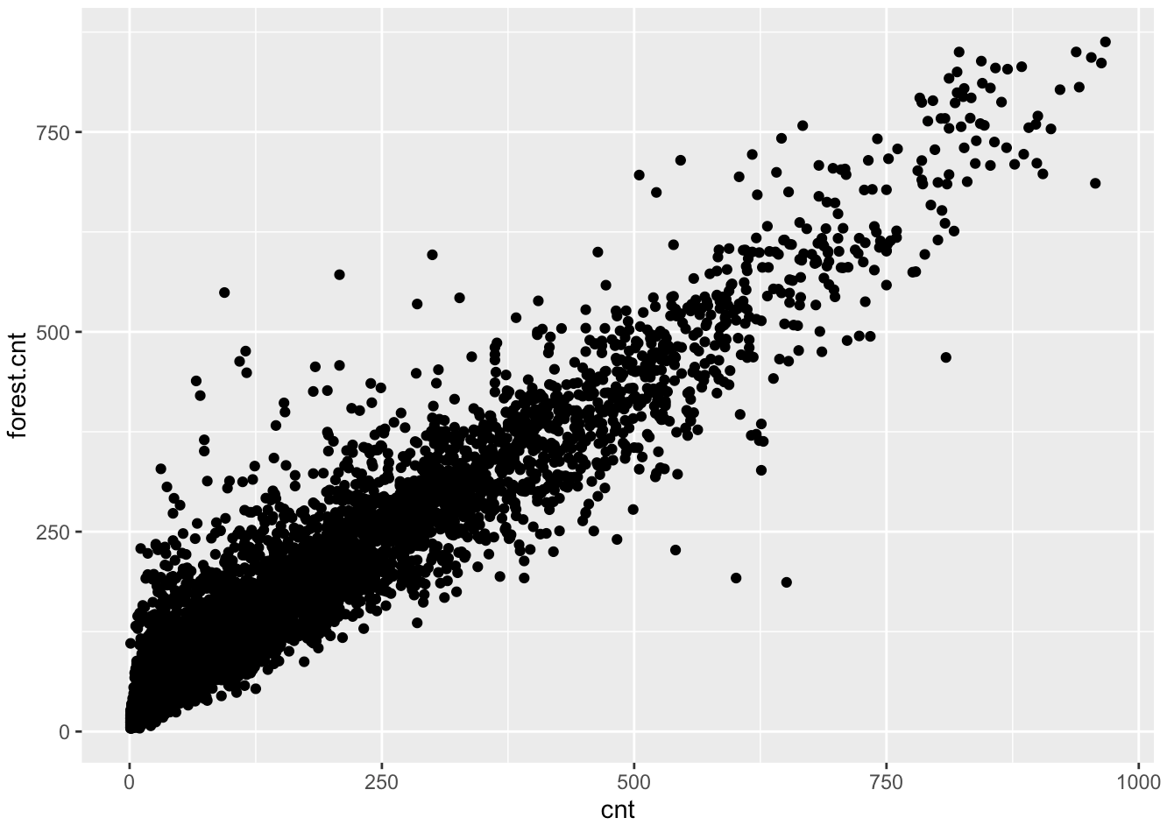
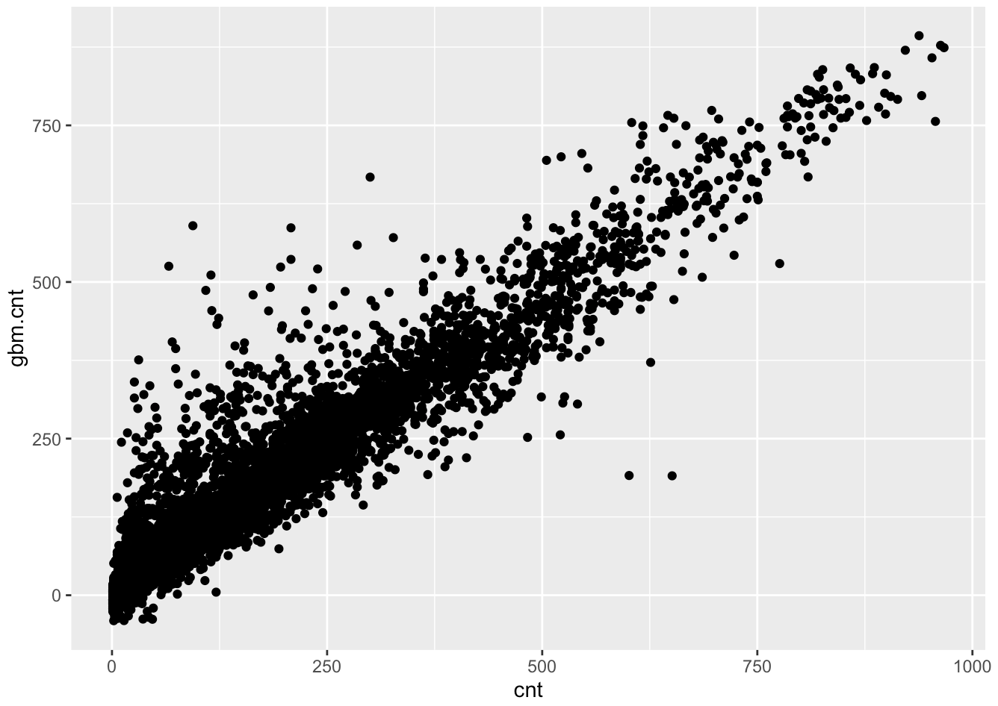
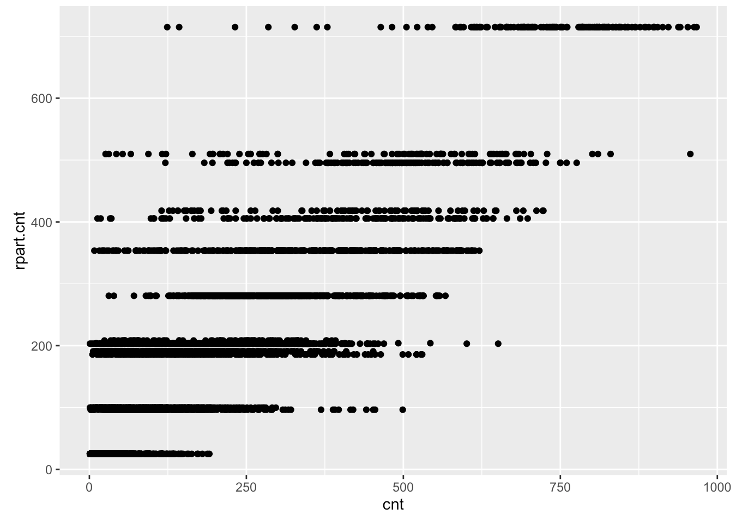
Model Selection
(1) Neural Networks
(2) Linear Regression
(3) SVM
(4) Random Forest
(5) GBM
(6) Regression Tree
Notes:
These models presented all run by the total rentals, then we run the models with two segments:
Registered users, and random users.

Slide 10
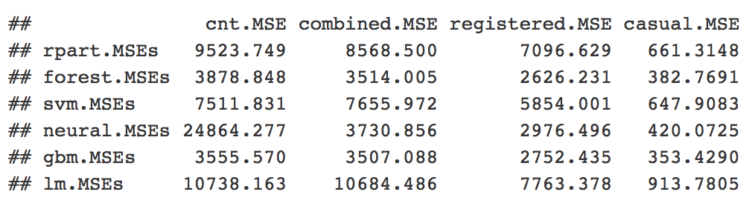
Model Comparison (MSE)

Slide 11
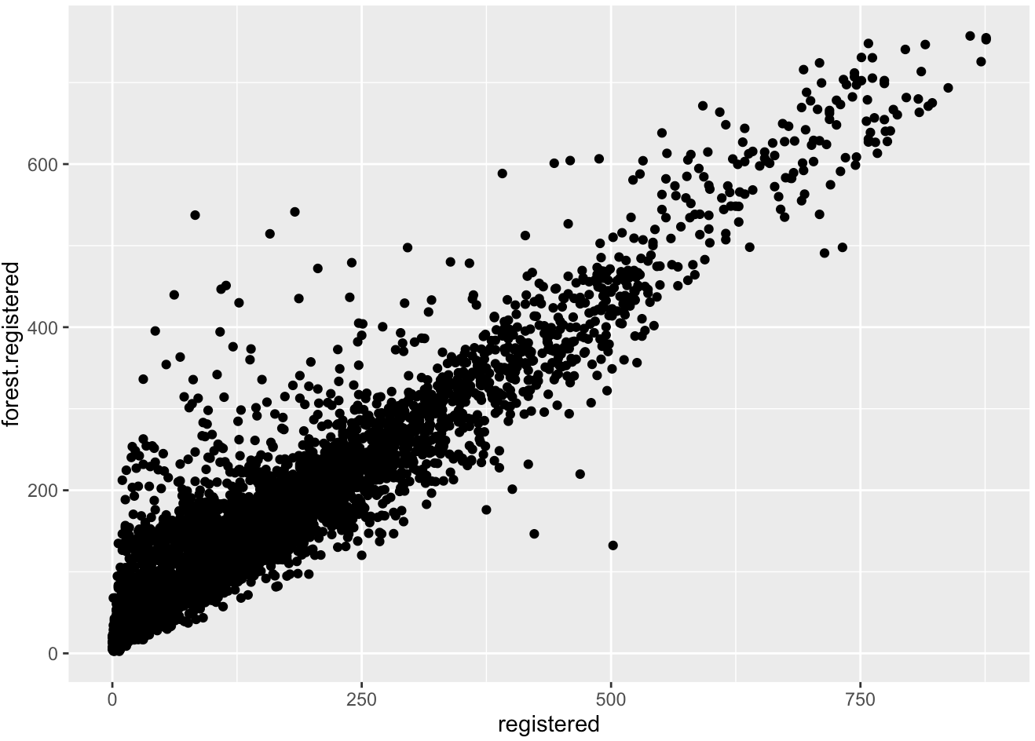
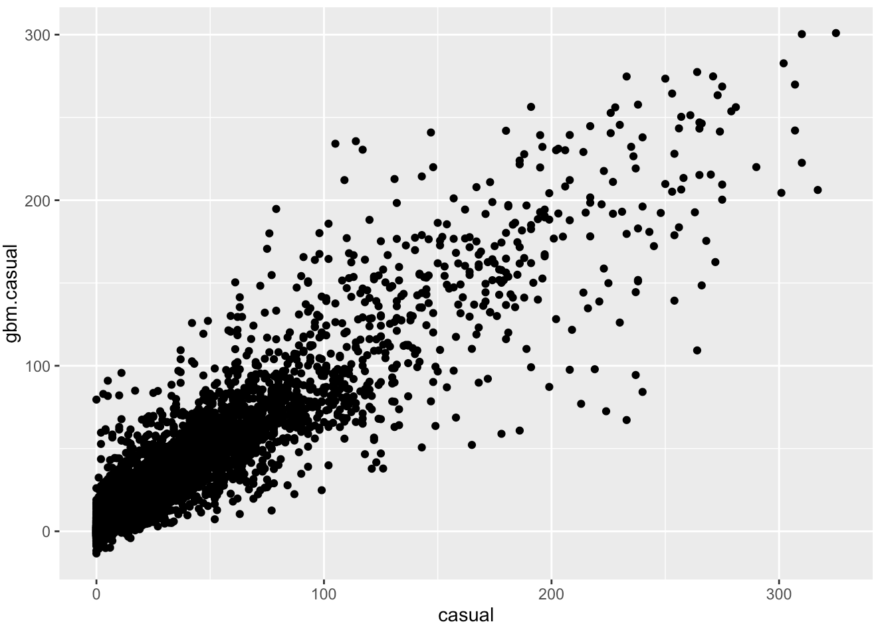
Model Selection
Best Prediction:
For Registered Users: Random Forest
For Casual Users: GBM
Transform them to our Ideal Model
Random forest model on registered users
GBM model on casual users
Notes:
For registered users: random forest provides best prediction (lowest MSE)
For Casual users: GBM got the best result
However, predicted results of random forest and GBM contain unwanted negative values, so we have to manually convert them to 0.
This transformation is crucial, because the final output we like to generate is the total number of rentals, which are derived from the predicted registered user (by RandomForest) and predicted casual users (by GBM).
With this additional step, we got the least MSE, which essential would be our ideal model.

Slide 12
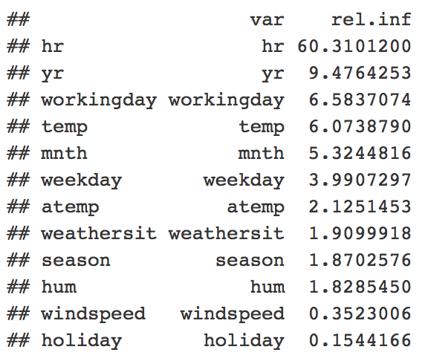
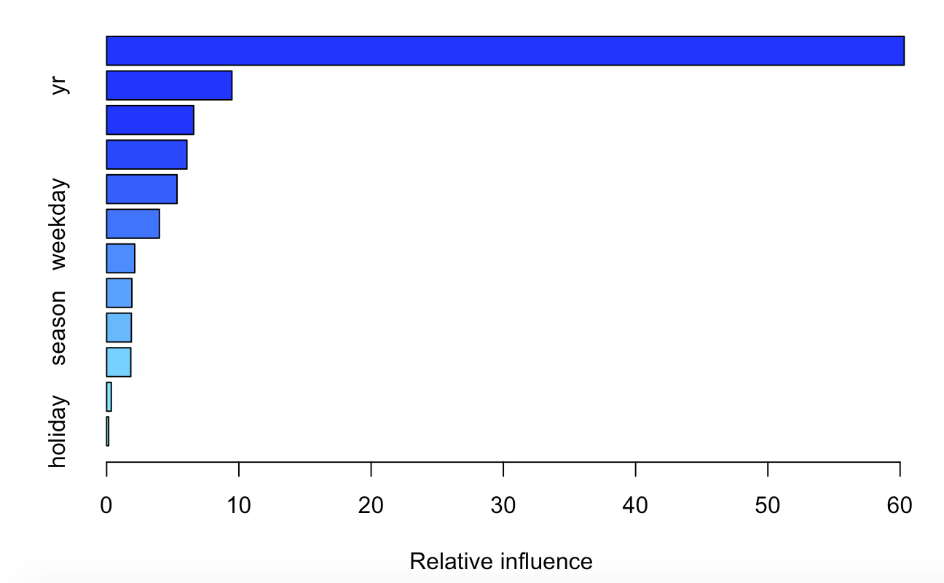
Which variables are significant?

Slide 13
Important Variables
Four Factor Groups:
hr
yr, mnth
working, weekday, holiday
temp, atemp, humidity
Notes:
Important Variables (Relative Influence)
cnt: hr, yr, workingday, temp, mnth, weekday…..
registered: hr, workingday, yr, mnth, weekday…..
casual: hr, weekday, temp, workingday…..
Because of the similarities among these factors, we subjectly grouped them into 4 different factor groups and visualized the plottings against “cnt” (Total users), “registered” (Registered users), and “casual” (Casual users).

Slide 14
Exploration
Visualize the story behind the scene.

Slide 15
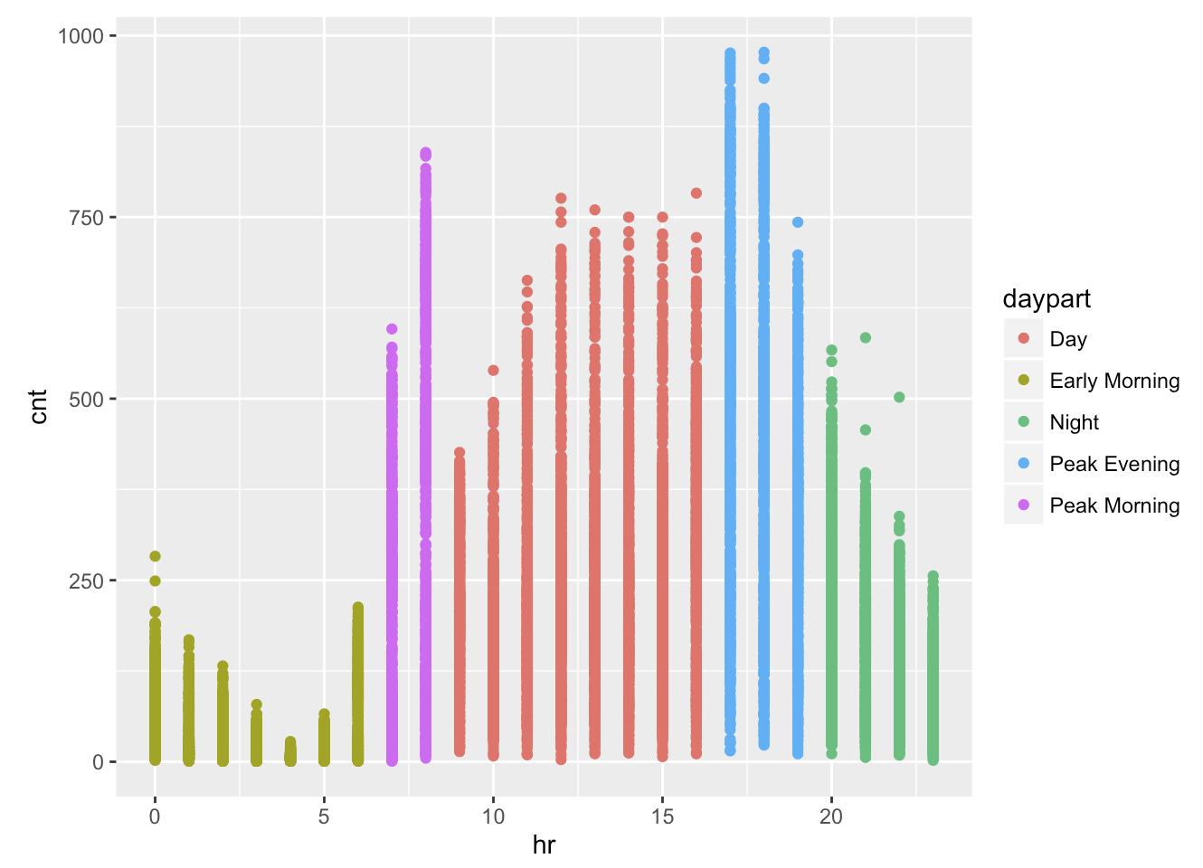
Manually Divided into 5 day parts
Early Morning
0 - 6
Peak Morning
7 - 8
Day
9 - 16
Peak Evening
17- 19
Night
20- 23
Total Users by Hour
Notes:
Since hour is the most significant factor for both registered and users, we plot a diagram on # of Bike Rentals vs. Hour of the Day from Sunday to Monday

Slide 16
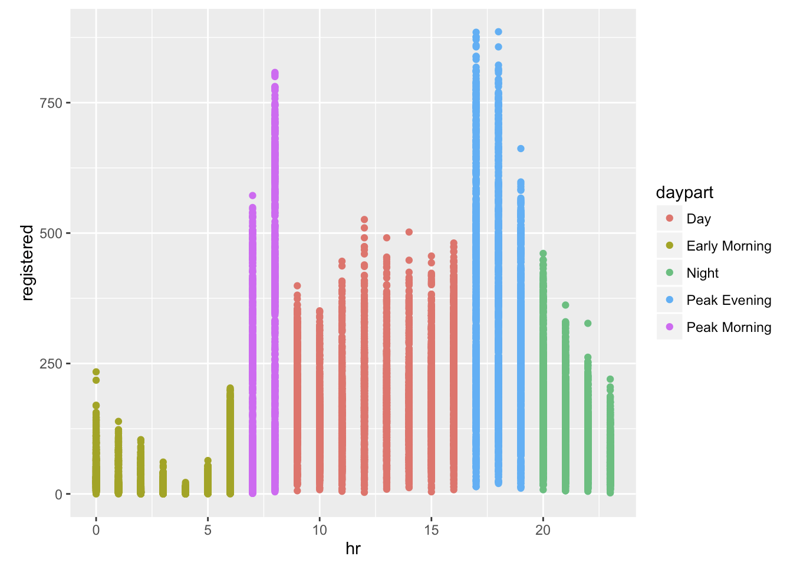
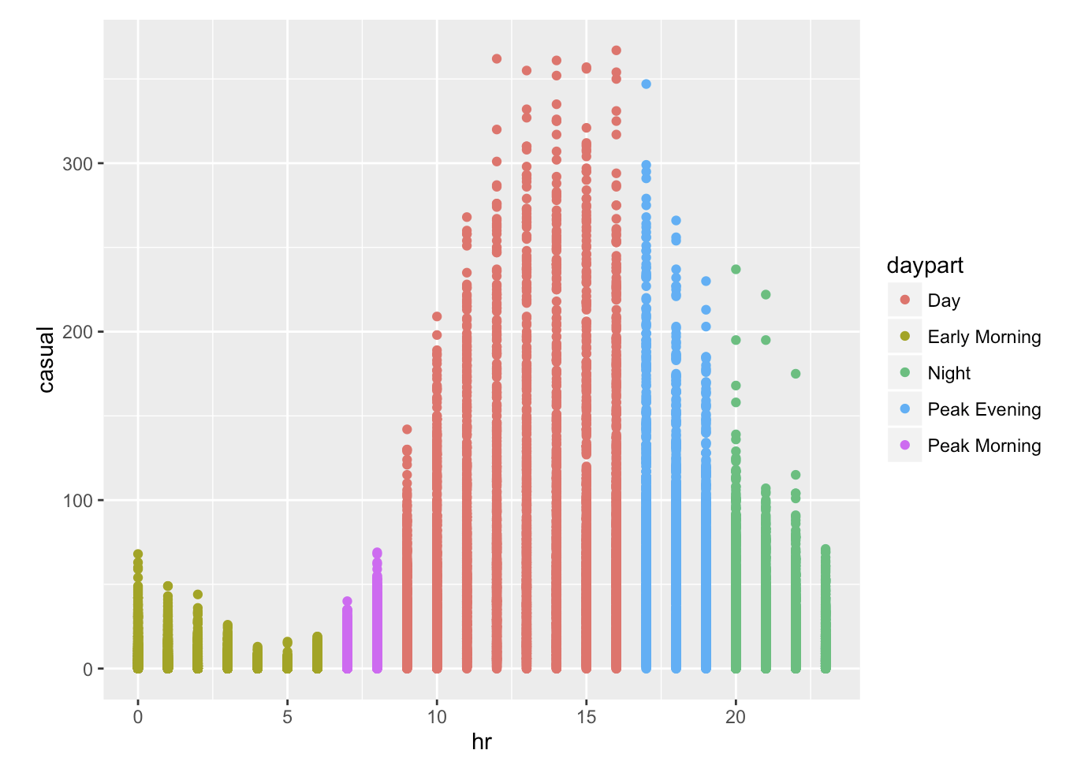
Registered Users
Casual Users
Notes:
Since hour is the most significant factor for both registered and users, we plot a diagram on # of Bike Rentals vs. Hour od the Day from Sunday to Monday

Slide 17
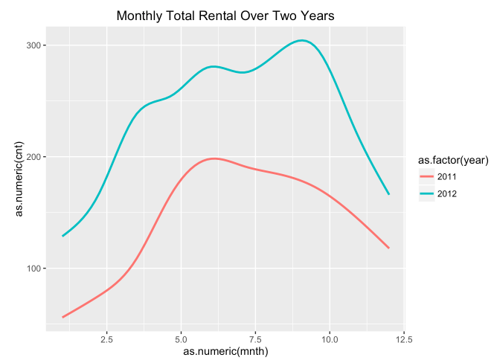
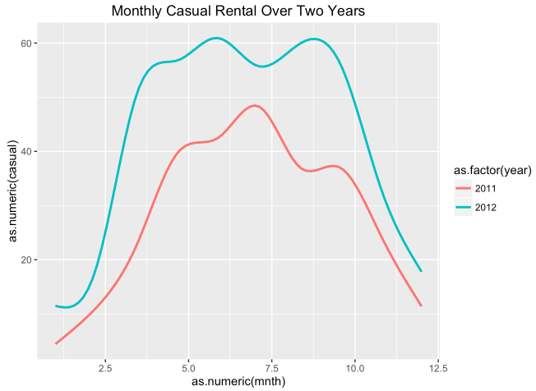
YEAR & MONTH
Registered
Monthly rentals over two year
Both registered and casual users increased
Insights:
A jump in August 2011 on registered users
Lower usage in winter
More casual users in Spring and Fall
Contrastly, smooth pattern on registered users
Casual
Notes:
in the graph, 0 stands for 2010 and 1 stands for 2011
Not only did the ridership of registered users increase significantly, there is also an interesting pattern. While the ridership of registered users of the first 7 months increased steadily, it appeared to be a jump from August in 2011. This might result from new policies or other environmental factors (perhaps the weather became much hotter at Fall 2011).
Also, in winter, usage is lower, which may be related to the lower temperature.
There were more casual users in spring and fall than summer and winter. This fact also explained why casual users are more affected by the environmental settings than registered users.
Recall the last graph, as compared to casual users, registered users are not as much influenced by environental factors as are causal users, because registered users of which contains a lot bike commuters still use the service, or they still have to go to work, even the weather is bad, .

Slide 18
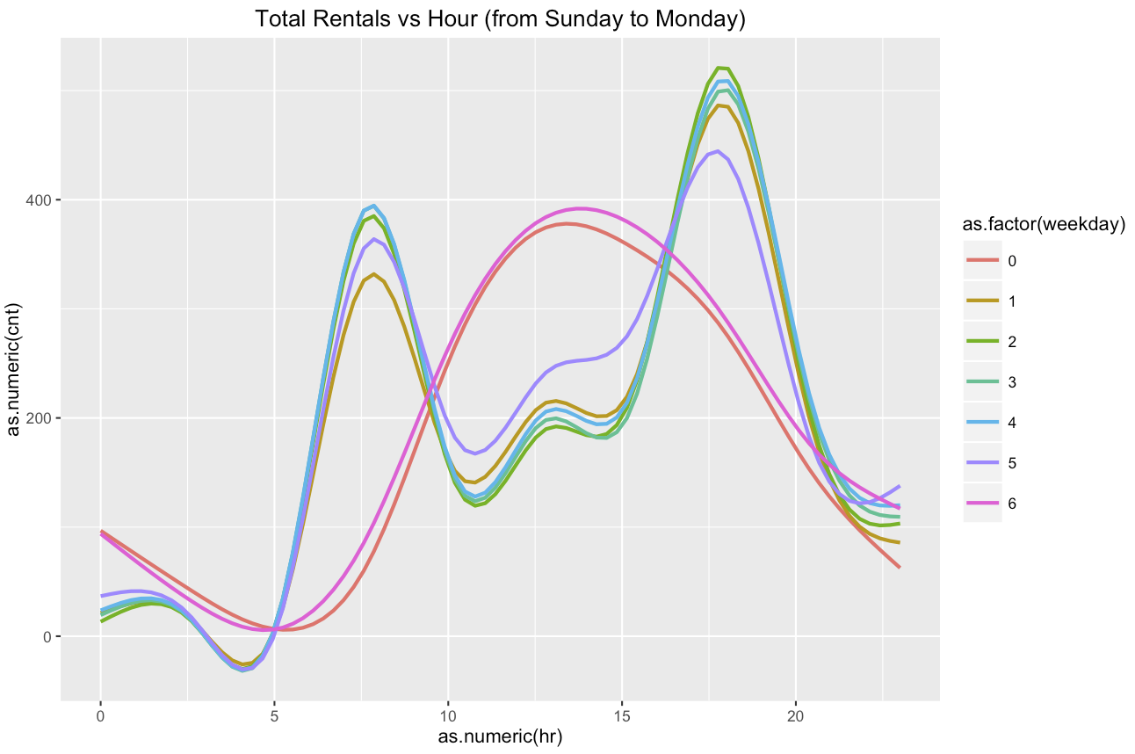
Weekdays
Two rental peaks: 7am - 8am and 5pm - 6pm
Usual commute hours
Weekends
Most rentals happen in mid of the day
Smooth curve
Weekdays V.s. Weekends
Notes:
Since hour is the most significant factor for both registered and users, we plot a diagram on # of Bike Rentals vs. Hour od the Day from Sunday to Monday

Slide 19
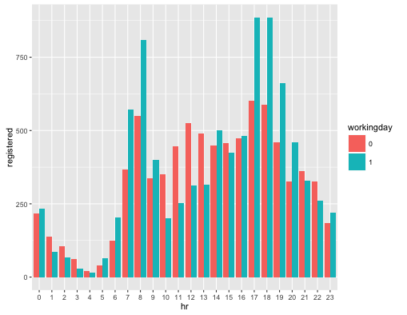
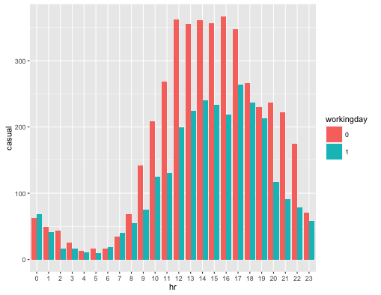
Working Day, Holiday
Registered
Given registered users (81%), casual users (19%) After evaluation:
On a working day, 87% of users are registered
Casual users increased from 13% on a working day to 32% on a non-working day
Insights:
Emphasize on providing the best service to the registered users on working days.
Care to casual users’ demand increased on non-working days, especially from 12pm to 17pm.
Casual
Notes:
On working days, the peaking hours are very obvious, while on non-working days, many people use the rental bikes in the afternoon. One way to look at this is that maybe on a non-working day, people like to use the service for fun.
On working days, most registered users used rental bikes during peak periods, meaning that, again, most registered users are bike commuters. On non-working days, their usage was less fluctuated.
Given that most of the users are registered users (81%), of all 19% of totall user are casual users, a lot of whom appear to use the services on a non-working day, especially in day time, when human activities are vivid.

Slide 20
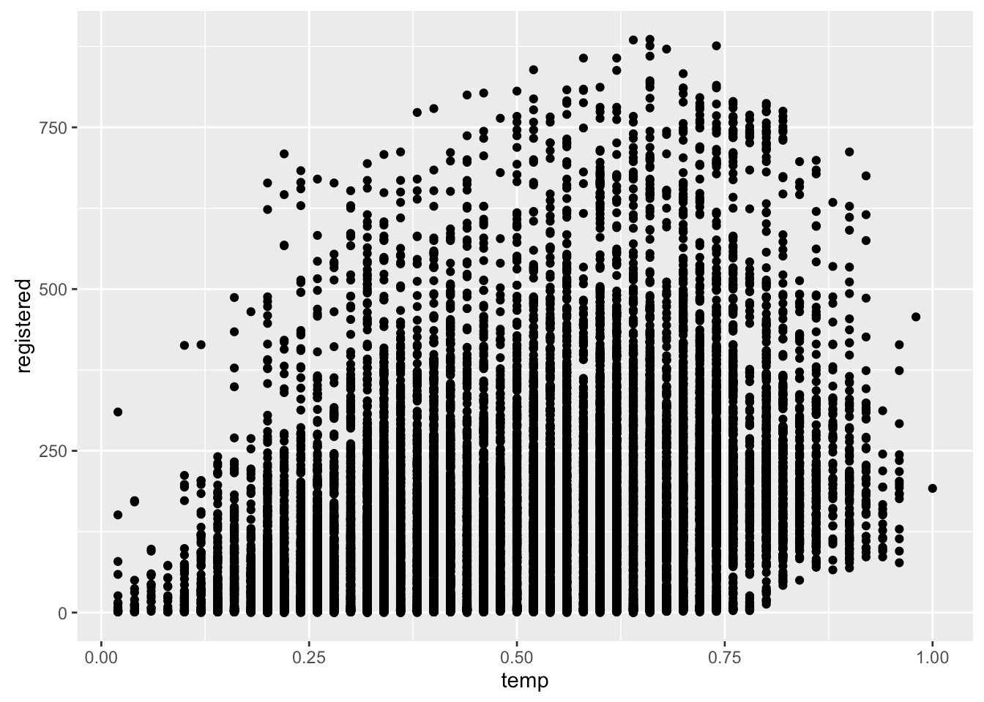
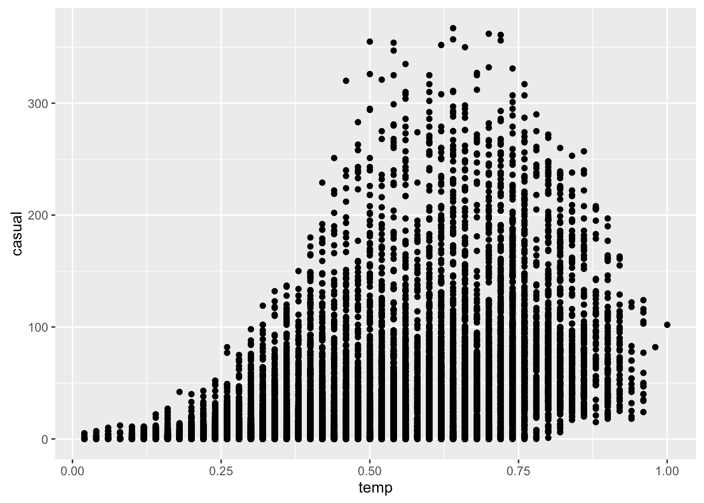
Temperature
Registered
Registered Users:
less affected by environmental settings.
Casual users:
sensitive to temperature.
Highest usage between 20℃ to 30℃.
When the temperature exceeds 30℃, the ridership of casual users dropped greatly.
Casual
Notes:
In the fourth factors group, we include the temperature, the feeling temperature and the humidity
Temperature is somewhat the same as the feeling temperature
So we only provide the comparison of temperature to the users in slide

Slide 21
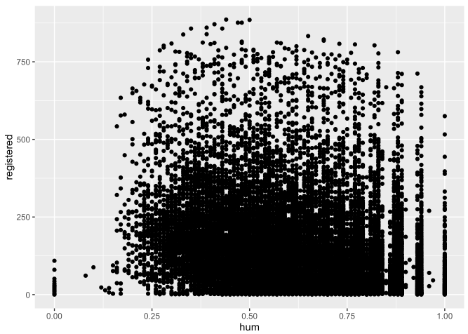
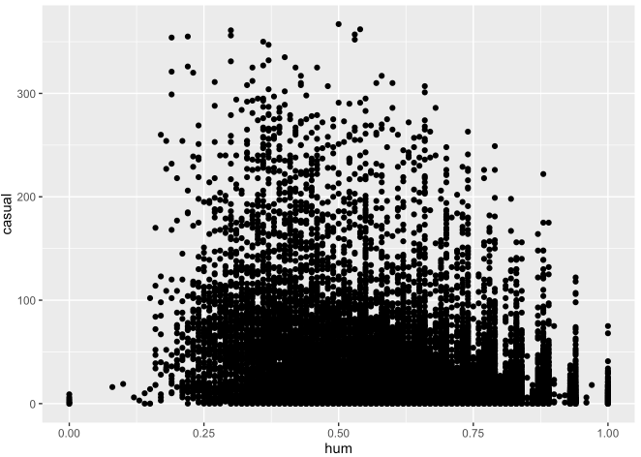
Humidity
Registered
Casual users are a bit more sensitive to humidity than registered users, but the casual usage is also kind of smooth except extreme humidity (e.g. heavy rain).
It indicates that biking activity is not relatively sensitive to humidity.
Casual
Notes:
Unless it’s the extreme weather, the humidity has little effect on the user.

Slide 22
Reflection
Most registered users commute to work by rental bike.
The increase in users on 2012, contributed majorly by registered users.
The usage pattern by hour differs a lot, on working days and non-working days.
Casual users are more sensitive to weather condition than registered users.
Notes:
The plotting results have confirmed our assumption that hr, mnth, workingday, temp, hum have major correlation with cnt/registered/casual. We also have the following interesting findings:
1) Most registered users commute to work by rental bike. While casual users do not.
2) 2012 saw an increase in users from 2011, contributed majorly by registered users.
3) On working days and non-working days, the usage pattern by hour differs a lot.
4) Casual users are more sensitive to weather condition than registered users.
The biking sharing system should allot bikes considering these facts.

Slide 23
Thank You
...Questions?

